Slide 1

NAMO ADHISTHA
Sign Language Translator
Submitted in the partial fulfillment for the award of the degree of
BACHELOR OF ENGINEERING
IN
CSE - AIML
Submitted by:
Manpreet Singh : 20BCS6444 - Leader
Nripesh Kumar : 20BCS6465
Yuvpartap Singh : 20BCS6448
Shreya Kohli : 20BCS6451
Under the Supervision of:
Dr. Neha Agarwal
Department of AIT-CSE
DISCOVER . LEARN . EMPOWER

Slide 2
OUTLINE
Introduction to Project
Problem Formulation
Objectives of the work
Methodology used
Results and Outputs
Conclusion
Future Scope
References

Slide 3
Introduction
Sign language is a set of gestures that deaf people use to communicate. Unfortunately, normal people don’t understand it, which creates a communication gap that needs to be filled. In this work, we present a computer vision system with neural networks architectures. The architecture is a CNN followed by a Long Short-Term Memory (LSTM) for extracting features.

Slide 4
Introduction
Sign language, as we know, is a way of communicating using hand gestures and movements, body language and facial expressions, instead of actually speaking. Like any other spoken languages such as English or Hindi, there are a bunch of different sign languages across the globe. As time passes technology is rapidly evolving and improving the way the world operates. Barriers for people with special needs are diminishing, as projects of the past two decades have unfolded.

Slide 5
Problem Formulation
Considering the present unfortunate pandemic situation which resulted in the immense increase in use of technology and digitalization. Our project mainly revolves around creating a machine learning model that would help the people with special needs in helping them adapt to these scenarios. One such way is by creating a model with the help of computer vision and deep learning which can assist people with special needs easing the communication process.

Slide 6
Objectives of the Work
Researching commonly used signs for communicating
Processing different landmarks used for locating and identifying hand signs
Generating dataset for frequently used signs during communication
Creating a model using created dataset
Adding customized signs and their meaning for quicker conversations
Predicting user’s message using generated model
Displaying and saying aloud predicted words

Slide 7
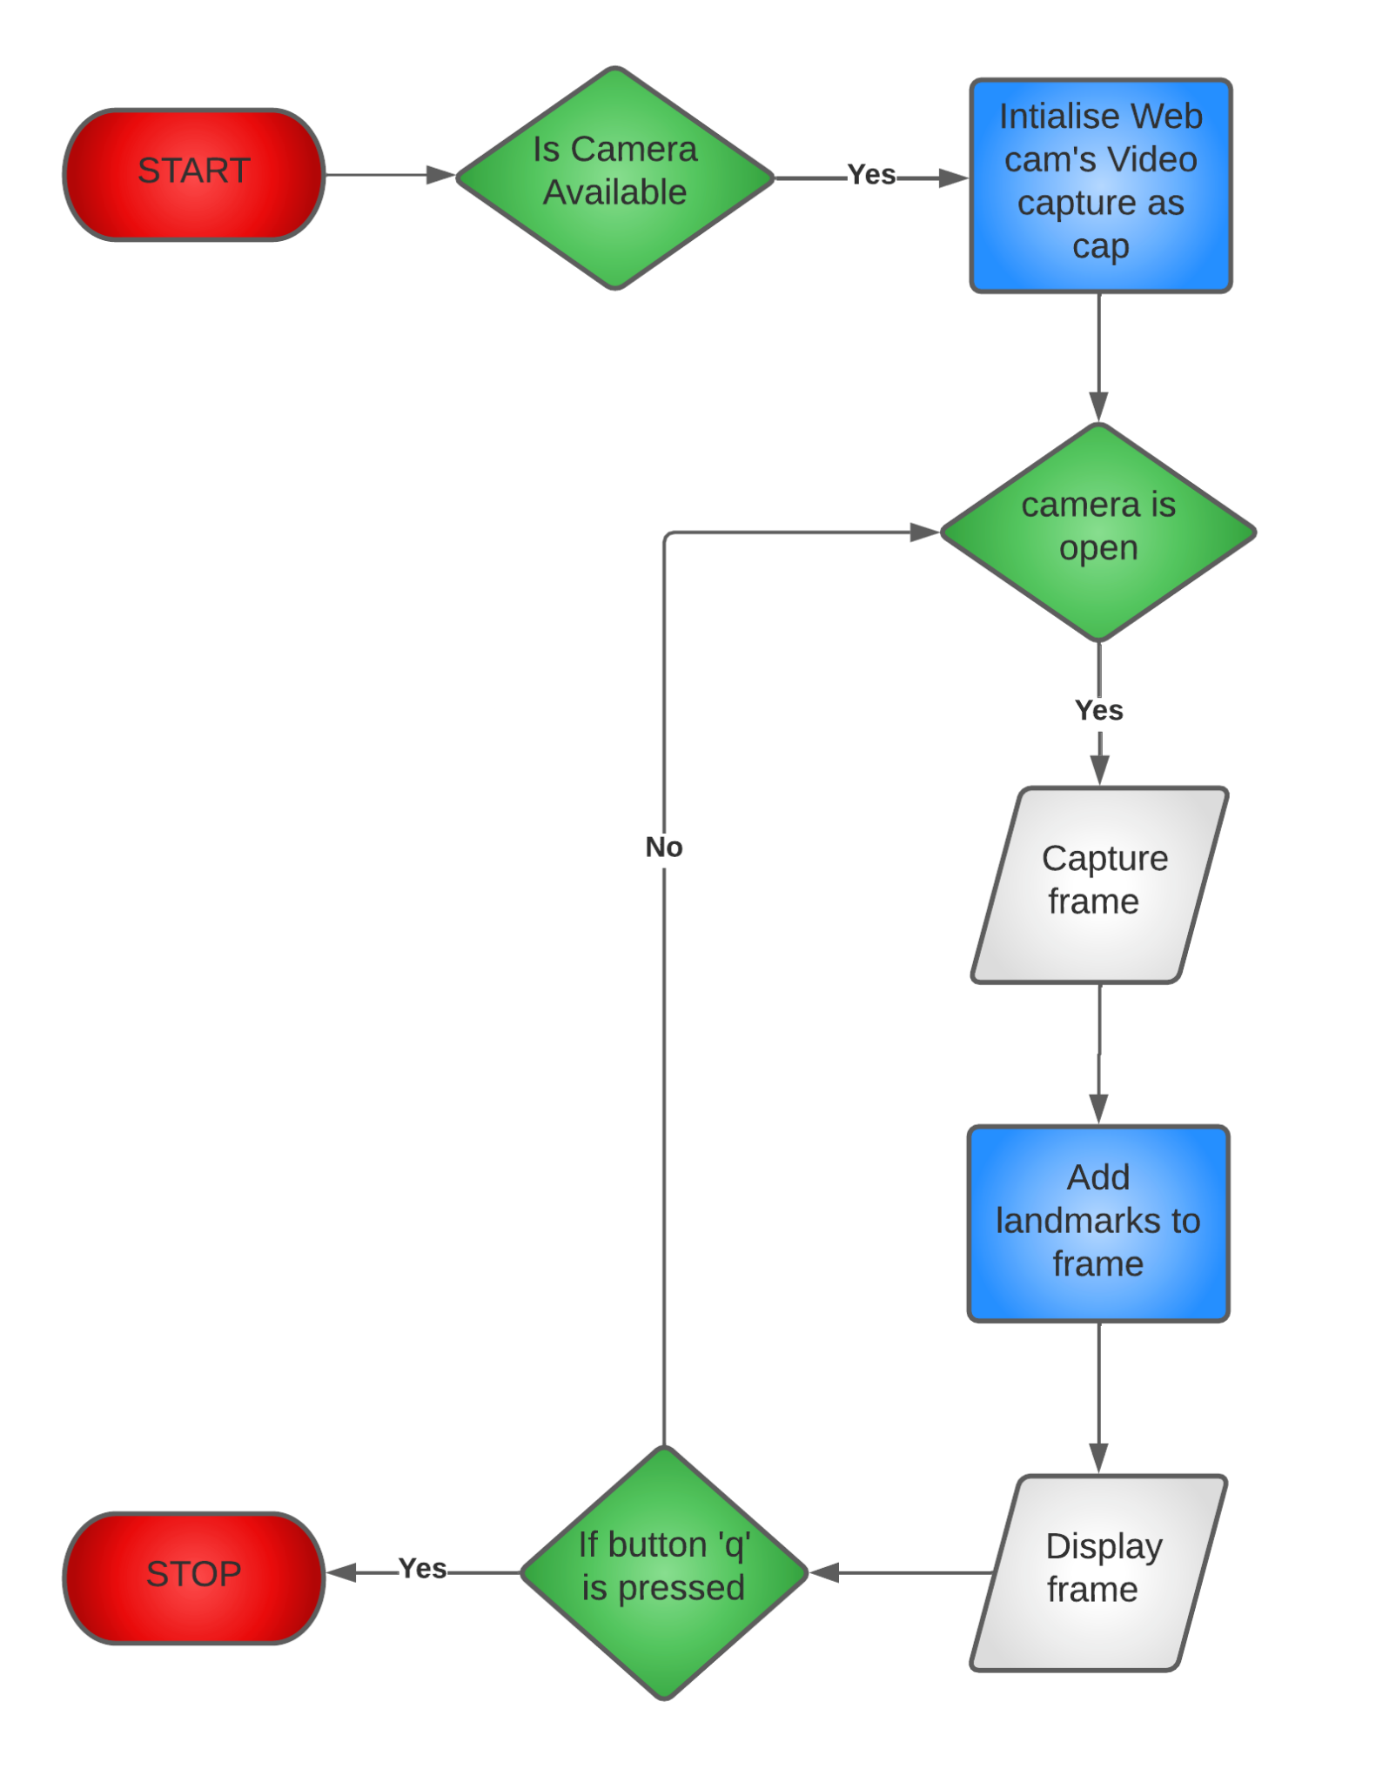
METHODOLOGY USED
Fig: Reading the camera frame and adding landmarks to the frame

Slide 8
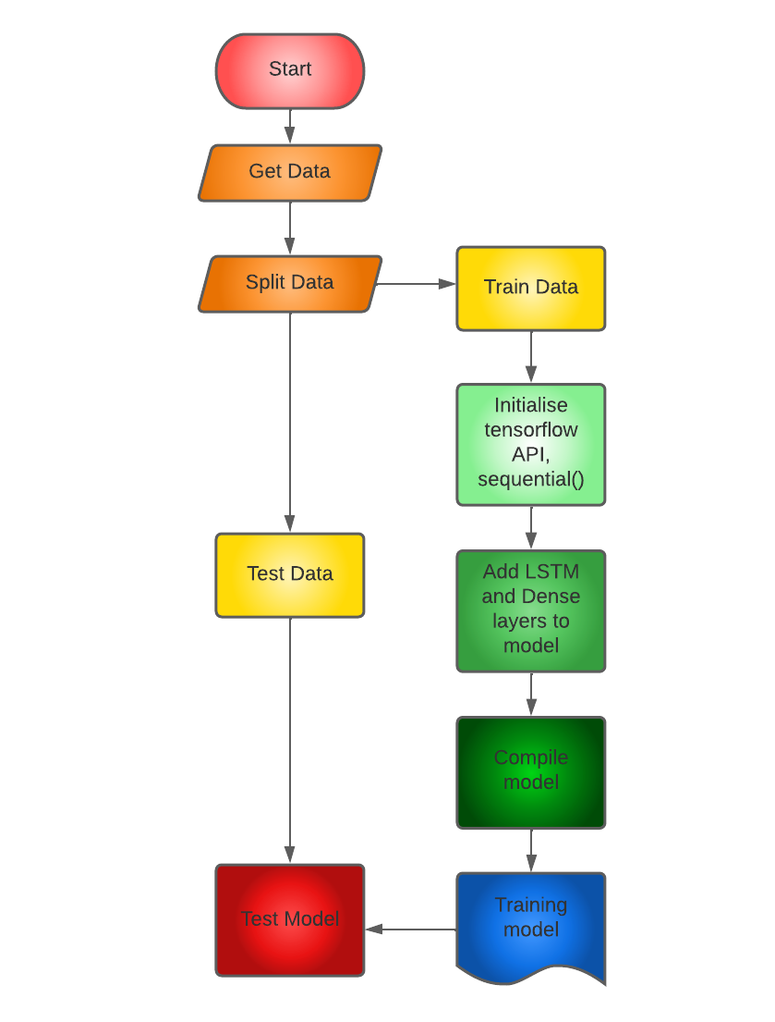
METHODOLOGY USED
Fig: Training the model by feeding dataset

Slide 9
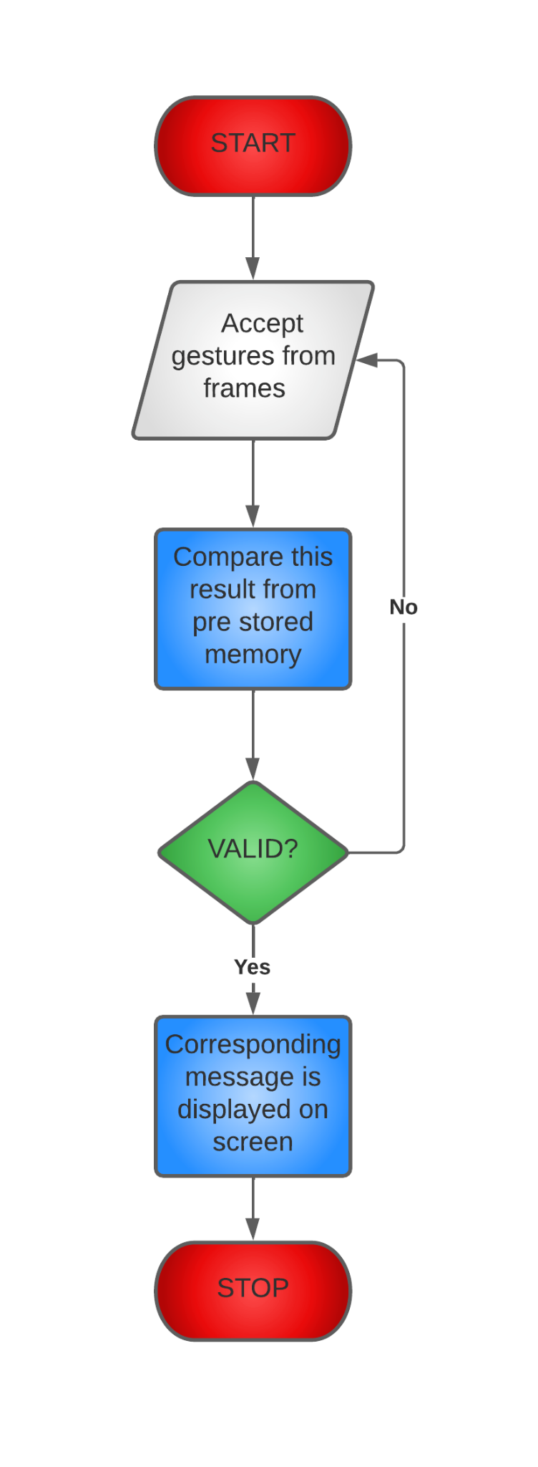
METHODOLOGY USED
Fig: Testing the model with GUI Application

Slide 10

Results and Outputs
Final Result/Outcome of Product

Slide 11
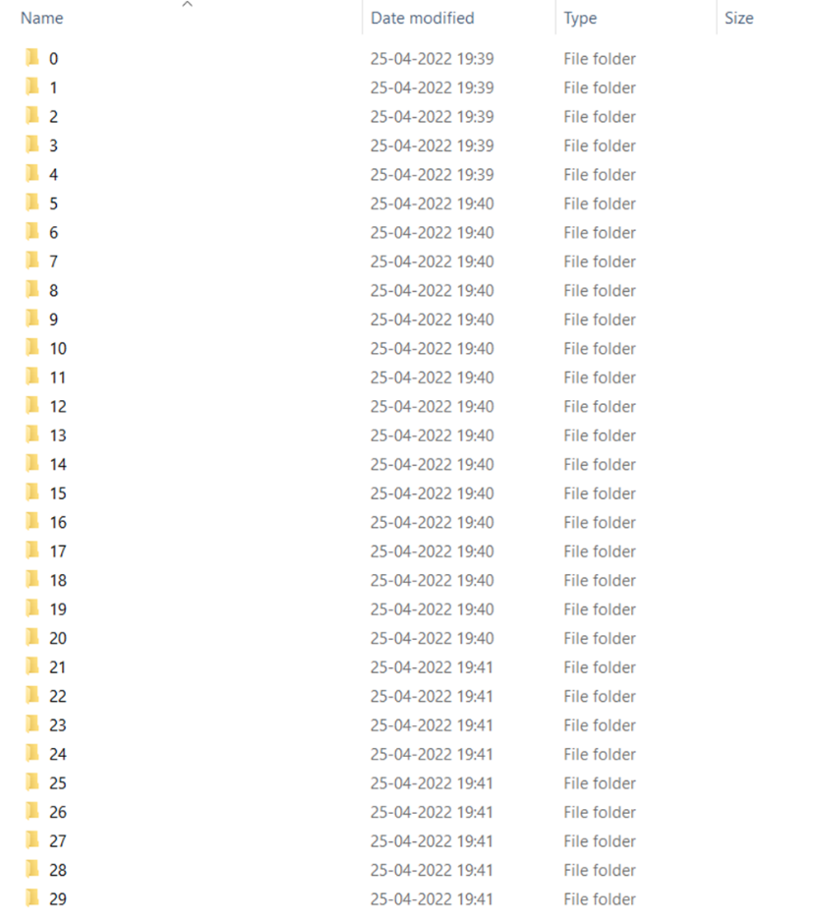
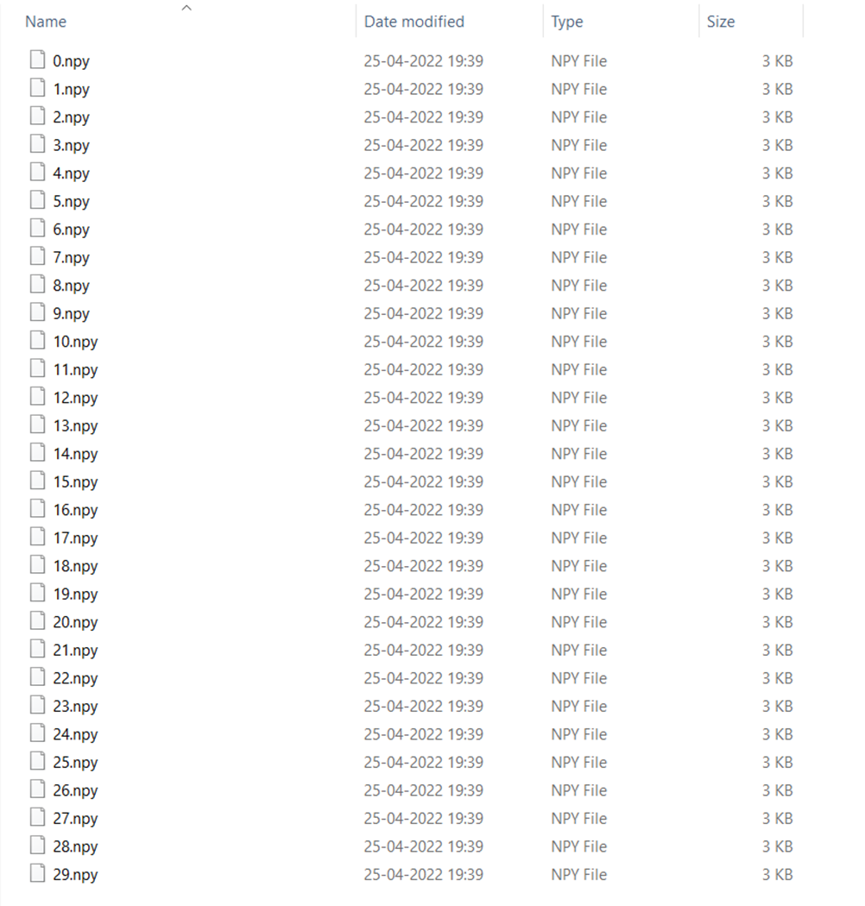
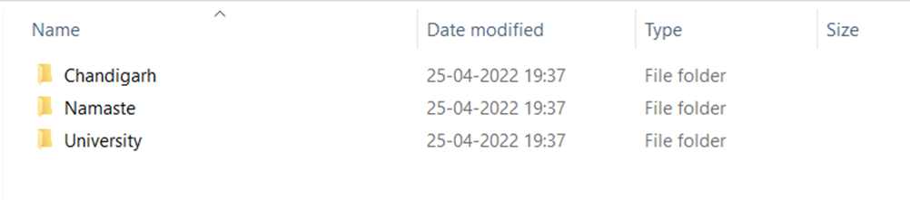
Data collection for three actions with 30 sequences in each and each sequence worth of 30 frames data
Fig: Three actions
Fig: 30 Sequences
Fig: 30 frames

Slide 12
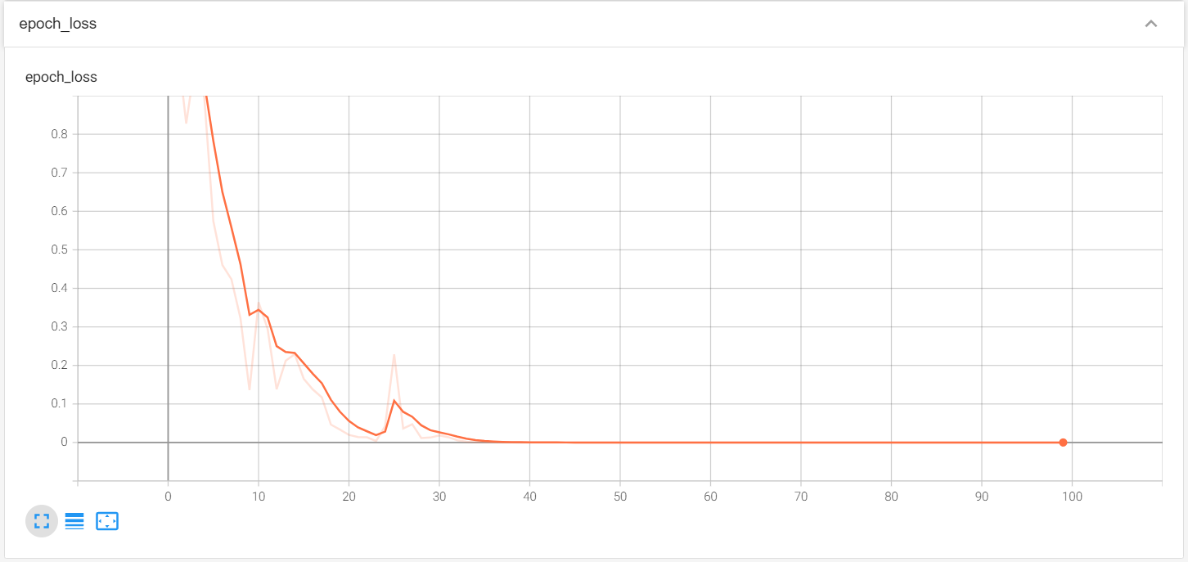
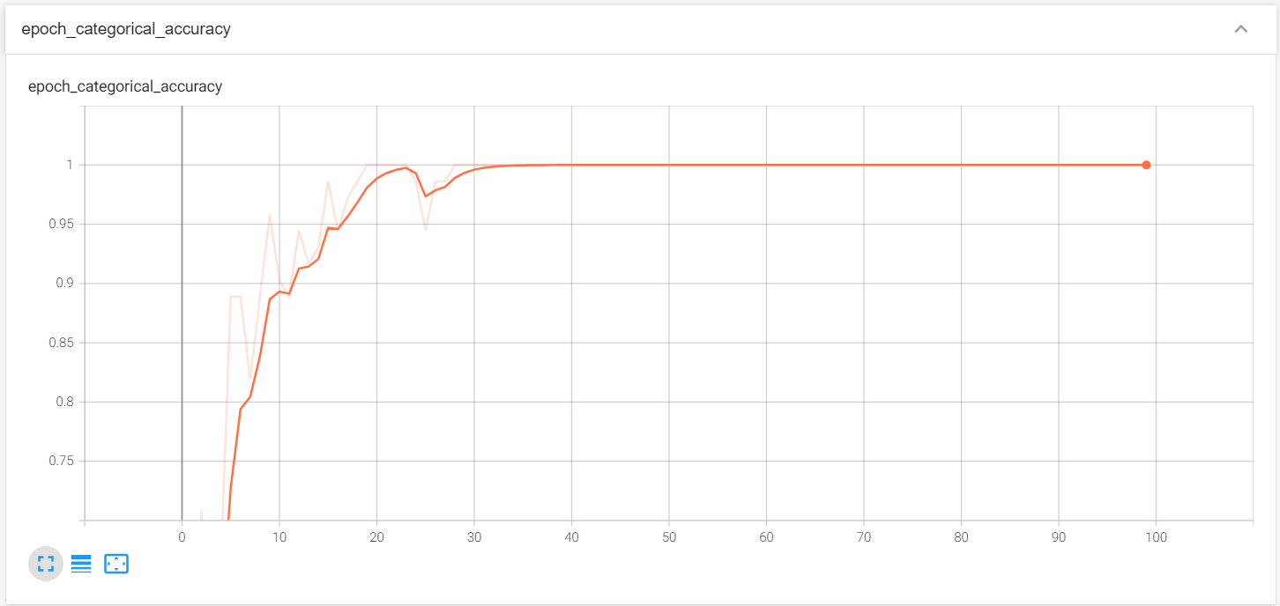
The Scalars dashboard shows how the loss and metrics change with every epoch.
You can use it to also track training speed, learning rate, and other scalar values.

Slide 13
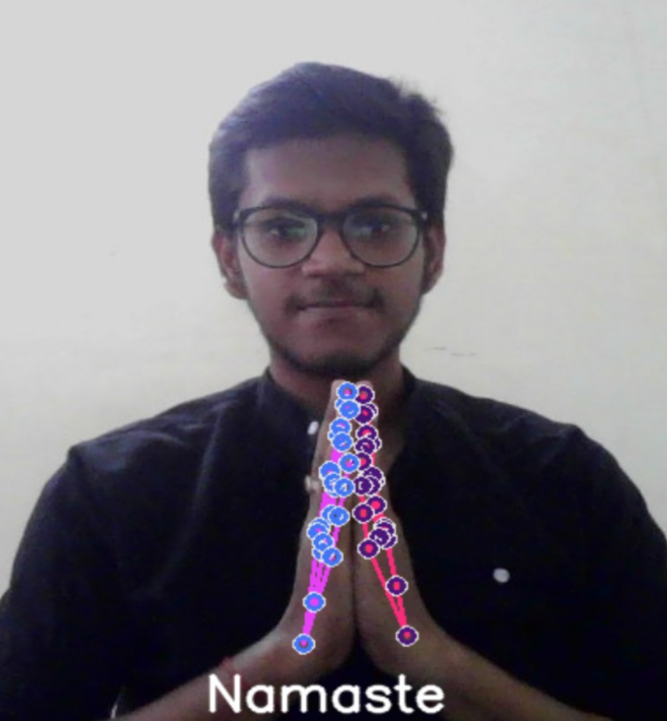
Demonstration By Nripesh Kumar

Slide 14
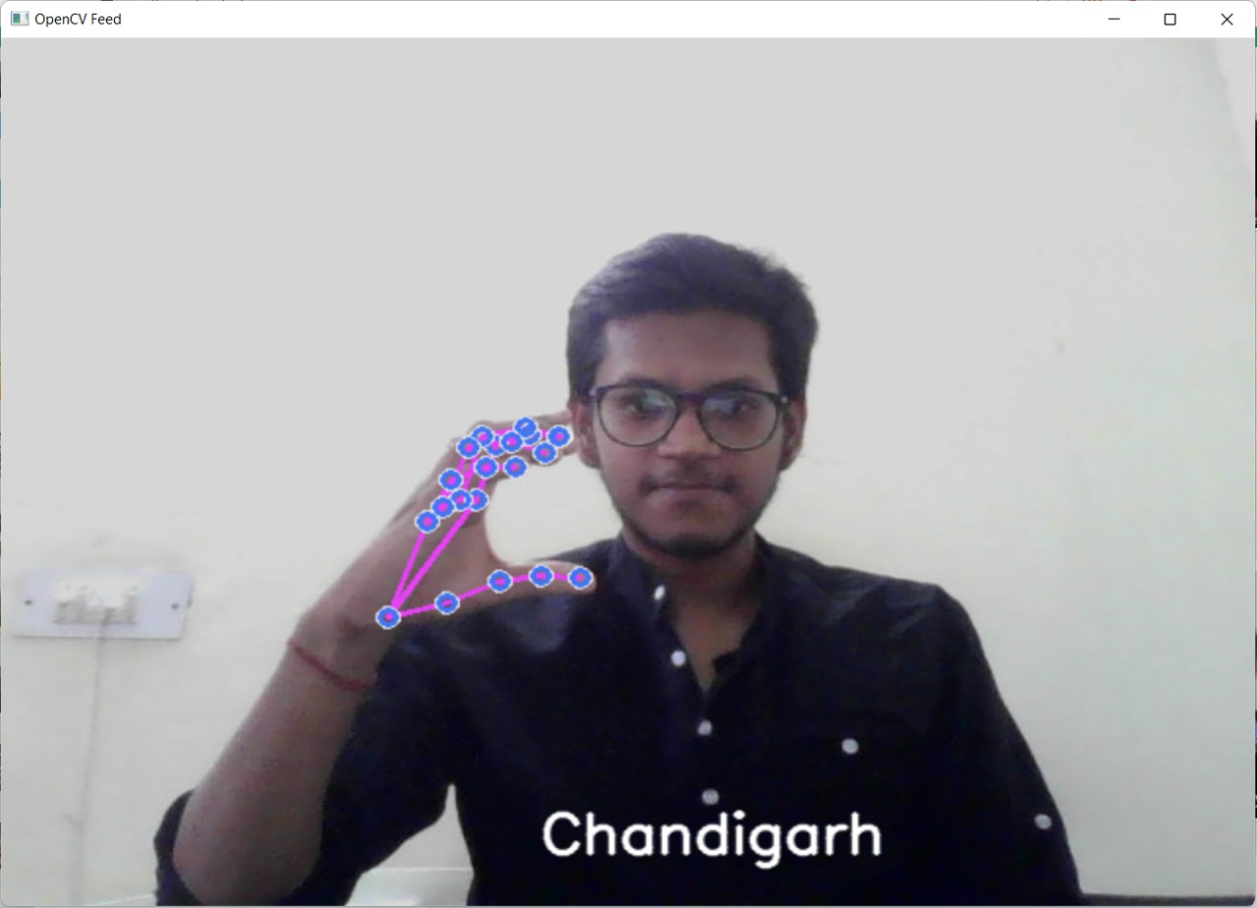
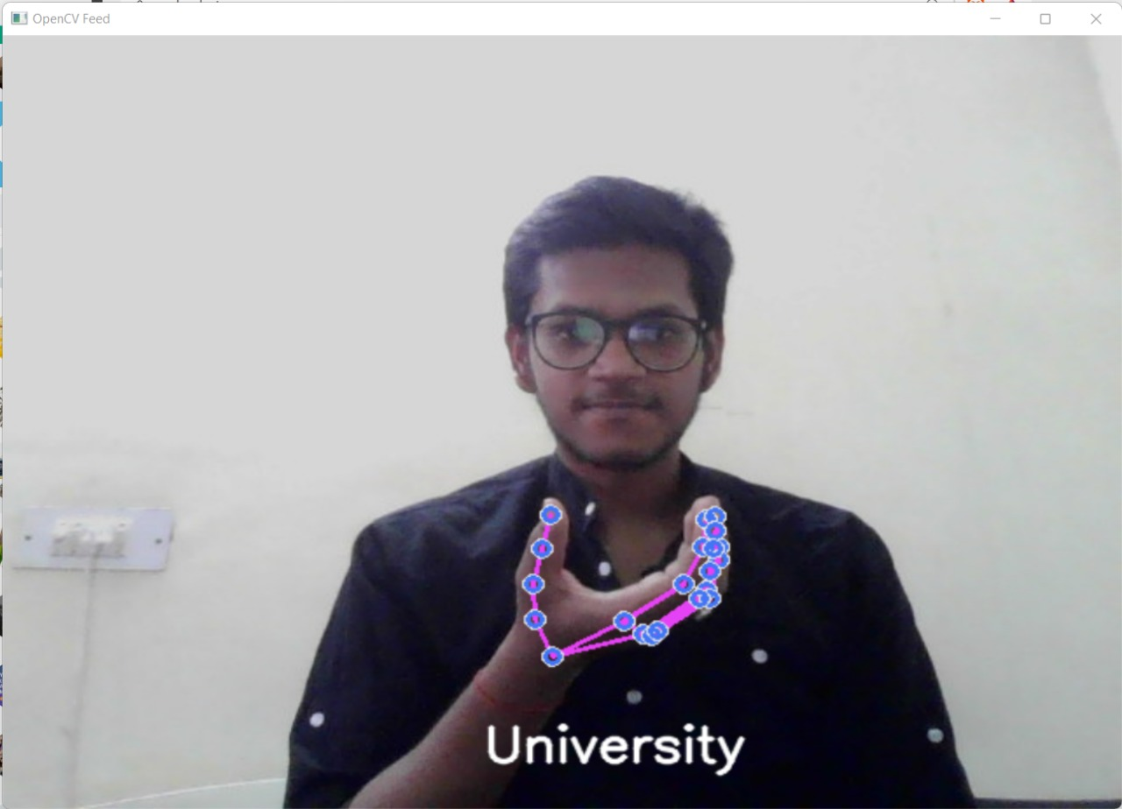
“Namaste Chandigarh University”

Slide 15
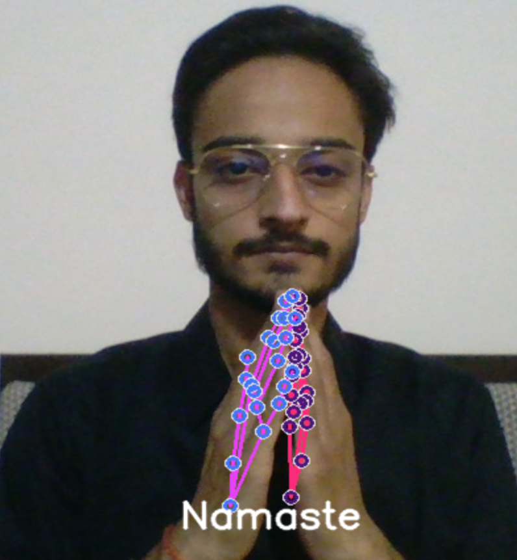
Demonstration By Yuvpartap Singh

Slide 16
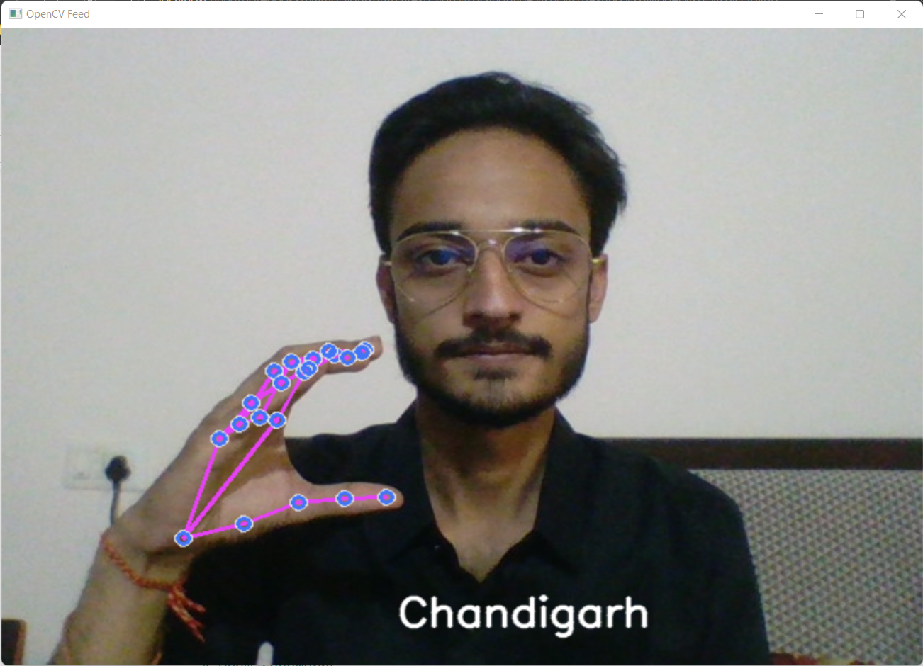
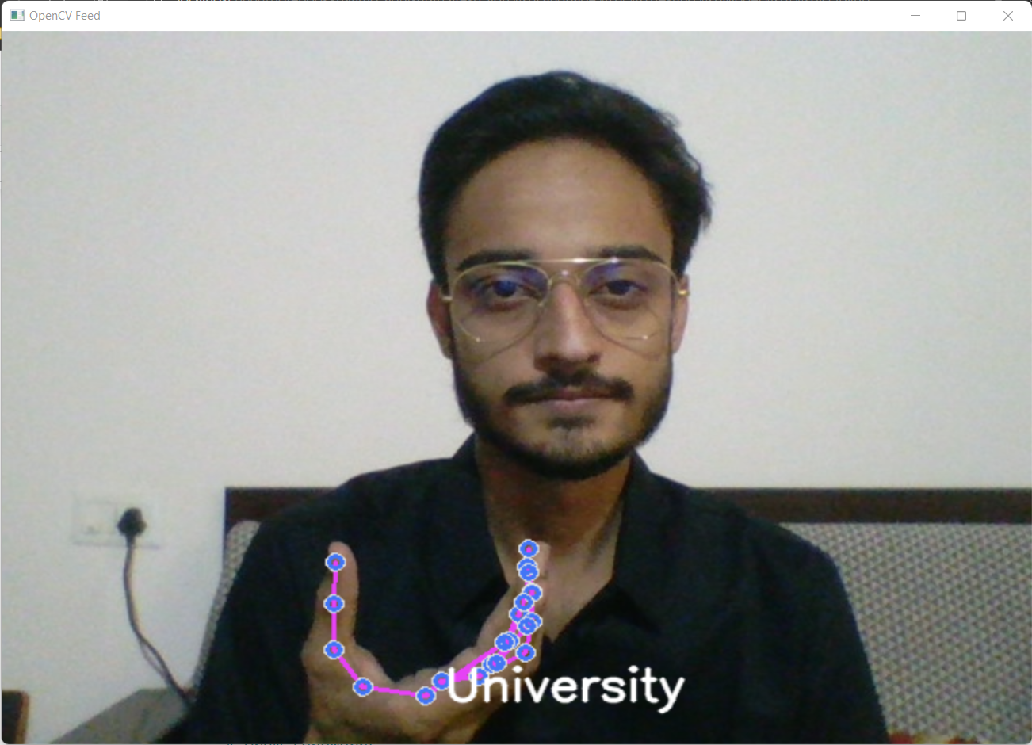
“Namaste Chandigarh University”

Slide 17
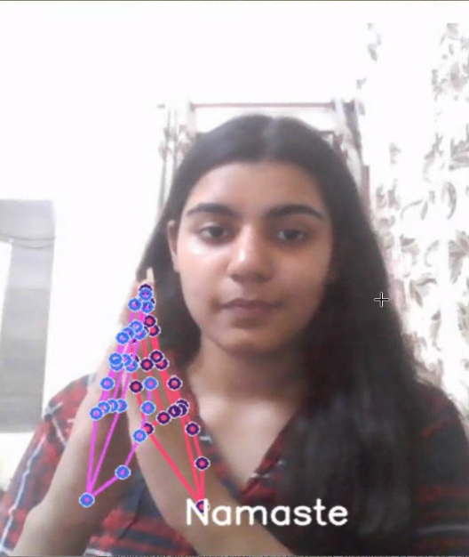
Demonstration By Shreya Kohli

Slide 18
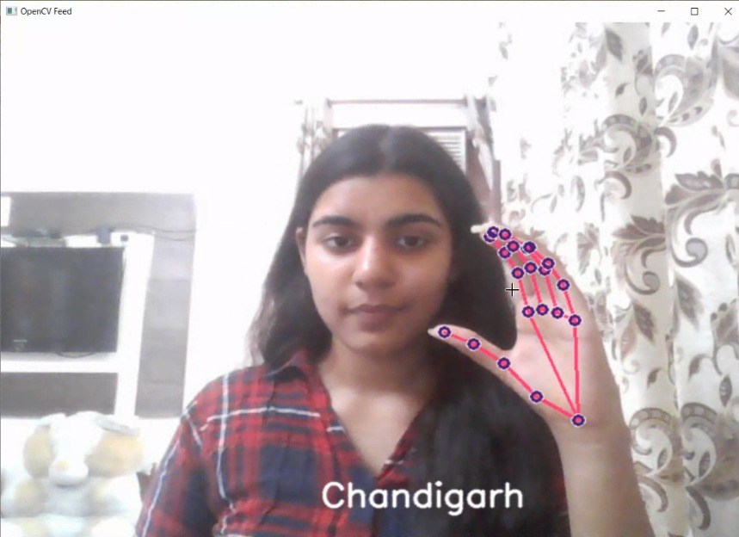
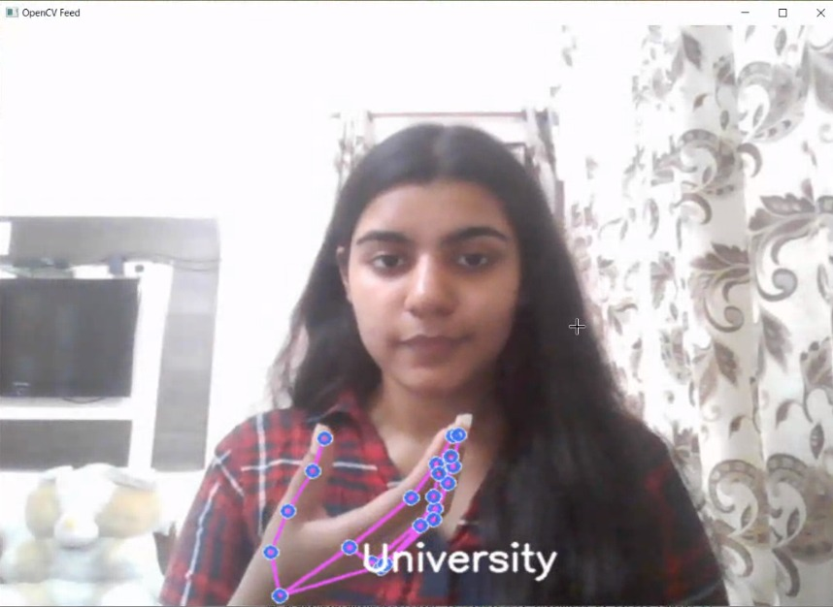
“Namaste Chandigarh University”

Slide 19
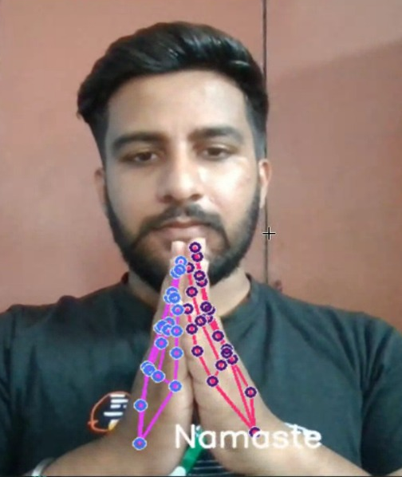
Demonstration By Manpreet Singh

Slide 20
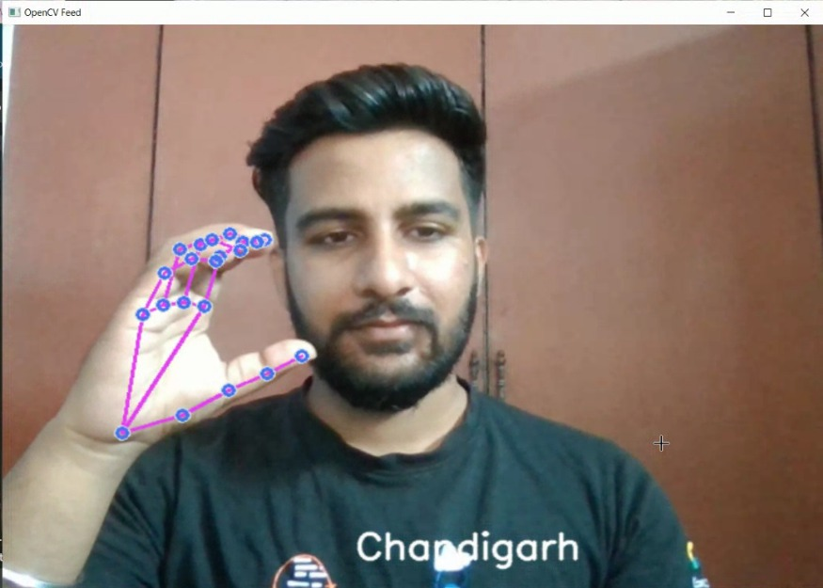
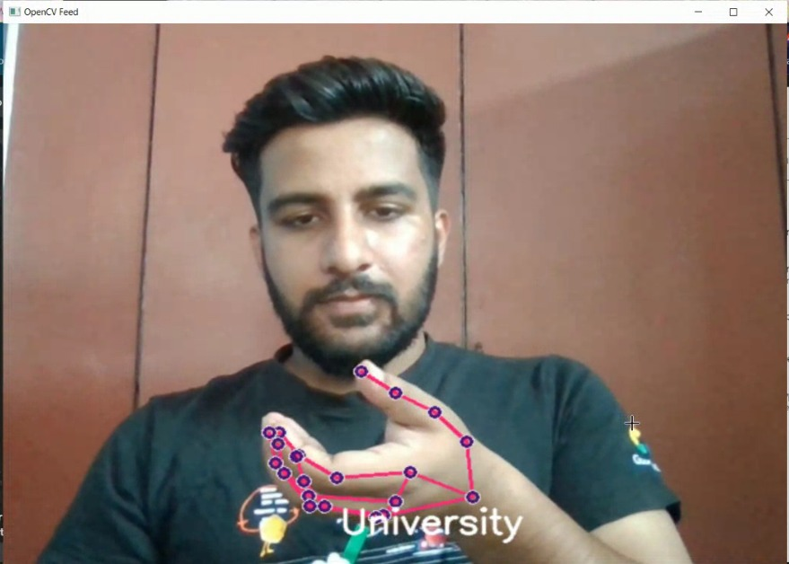
“Namaste Chandigarh University”

Slide 21
CONCLUSION
A full-fledged system for the ease in communication between an impaired person and the normal ones. Simply by monitoring the activity of hands, the data is fed to the machine learning model and then it is analysed for detecting the sign language of the hands. From this system we are trying to achieve communication with the help of finger gestures. This will provide a fluent mode of communication for the verbally challenged people.

Slide 22
Roadmap
Brainstorming and thinking of a project Idea
Extracting the hand and pose Landmarks using the Mediapipe holistic model
Feeding the dataset to the model for training
1
3
5
2
4
6
Researching and analyzing the existing models
Creating dataset consisting of video frames
Testing the trained model along with the Tkinter GUI Application

Slide 23
FUTURE SCOPE
Extending the application usability by providing a mobile application or an extension for browsers in pc
A stand-alone application capable of translating all types of languages including different spoken languages as well as other variants of sign languages.
Integrating it into a portable device containing a camera, mic and speaker.
Moreover, this software can be further integrated with the smart watches as well as in smart glasses such as i-glasses.

Slide 24
References
https://www.tensorflow.org/resources/learn-ml
https://google.github.io/mediapipe/solutions/holistic
https://docs.opencv.org/4.x/d9/df8/tutorial_root.html
https://indiansignlanguage.org/
Recognition of Indian Sign Language by H Muthu Mariappan & V Gomathi
http://cs231n.stanford.edu/reports/2016/pdfs/214_Report.pdf

Slide 25
References
http://www.iosrjen.org/Papers/vol3_issue2%20(part2)/H03224551.pdf
http://citeseerx.ist.psu.edu/viewdoc/download?doi=10.1.1.734.8389&rep=rep1&typ e=pdf
http://citeseerx.ist.psu.edu/viewdoc/download?doi=10.1.1.734.8389&rep=rep1&typ e=pdf
https://ieeexplore.ieee.org/document/7507939
https://ieeexplore.ieee.org/document/7916786
https://www.sciencedirect.com/science/article/pii/S1877050917320720

Slide 26
References
https://medium.com/@RaghavPrabhu/understanding-of-convolutional-neural- network-cnn-deep-learning-99760835f148
https://adeshpande3.github.io/adeshpande3.github.io/A-Beginner's-Guide-To- Understanding-Convolutional-Neural-Networks/

Slide 27

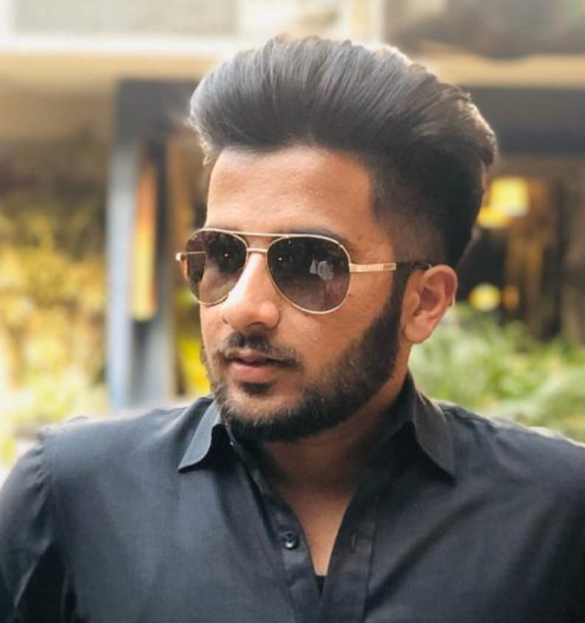
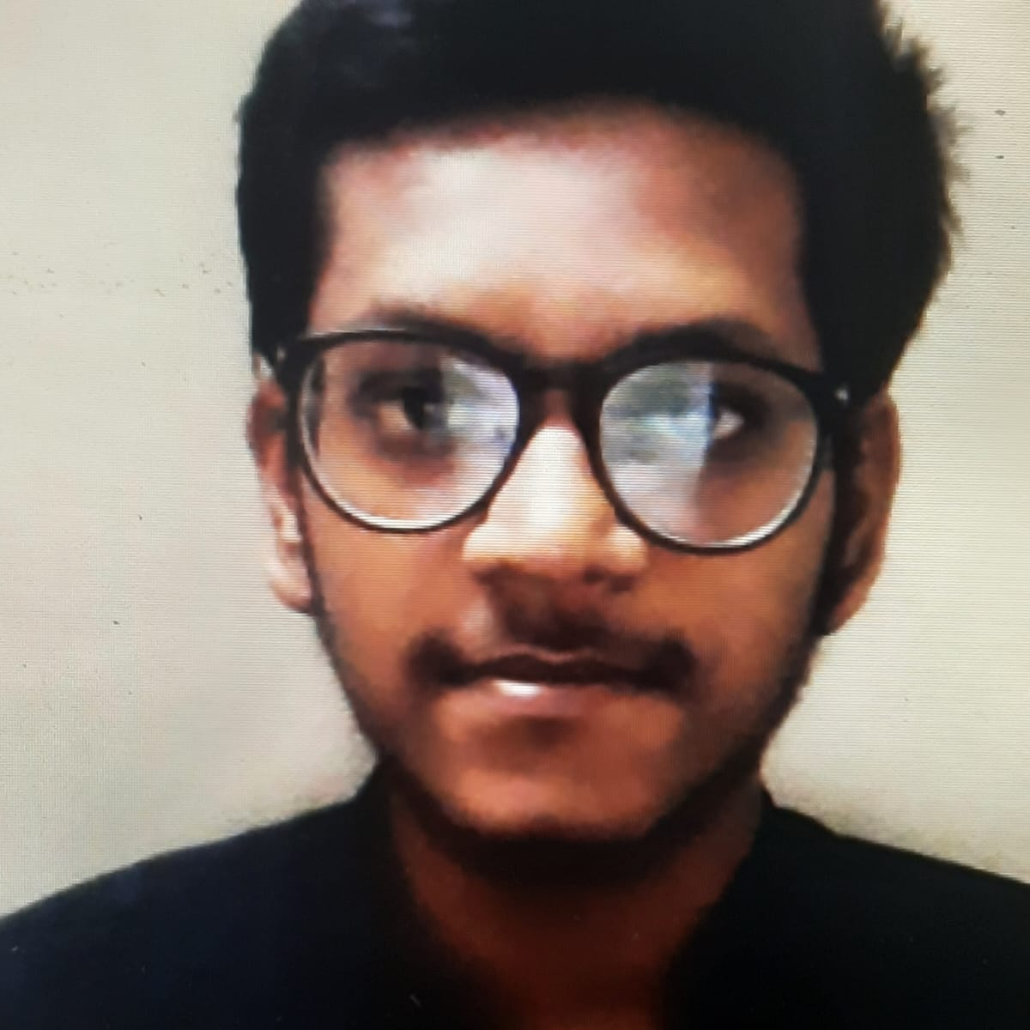
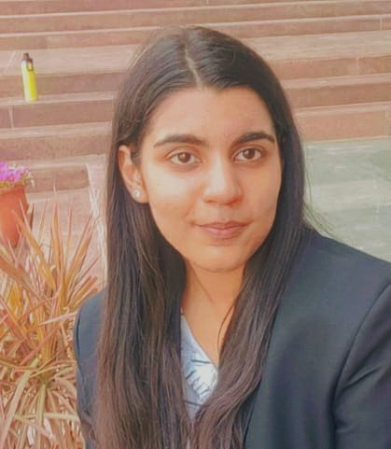
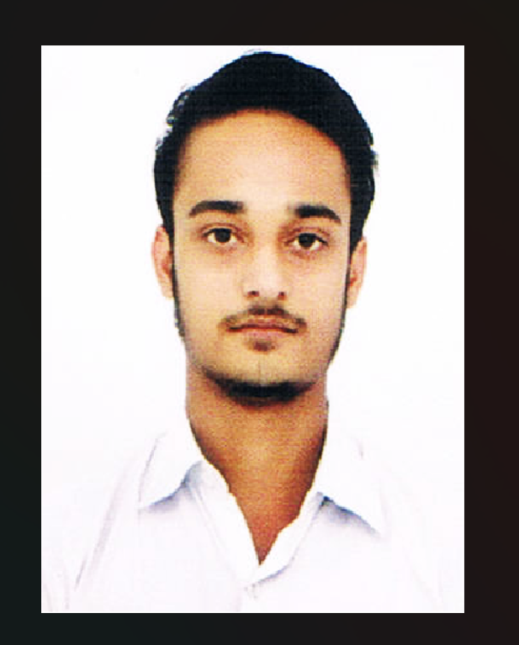
Team Presentation :
Manpreet Singh Team Leader
Nripesh Kumar Team Member
Shreya Kohli Team Member
Yuvpartap Singh Team Member

